Slide 1
The Gender Wage Gap Evidence from the Cohort Studies
Bożena Wielgoszewska
DRTN webinar
2nd October 2024

Slide 2

Project background:
Aim: to investigate the gap between men’s and women’s hourly pay over the life course and across cohorts, using evidence from the British Birth Cohorts
Team: Prof. Alex Bryson, Prof. Heather Joshi, David Wilkinson, Dr Francesca Foliano, Dr Bozena Wielgoszewska
September 2019 - June 2024 at UCL Social Research Institute
The project was funded by the ESRC grant number ES/S012583/1
Project website

Slide 3
Trends in aggregate data on the gender wage gap

Slide 4
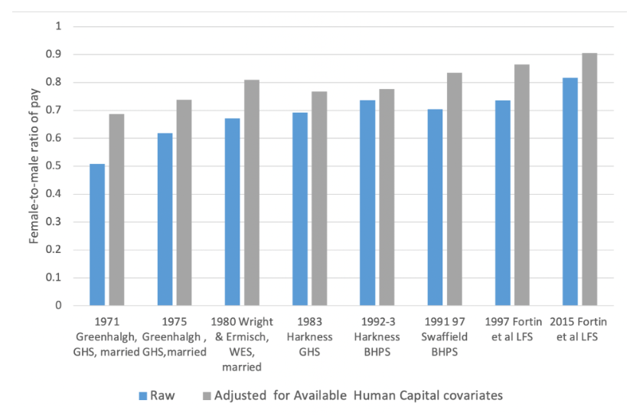
Female-to-male ratio in previous studies:

Slide 5
Timeline of policy context:
Statutory National
Minimum Wage
and National
Childcare Strategy
1999
Equal Pay Act
(into effect
January 1976)
1970
Equal Pay Amendment Act –
Implementation of work of
equal value Directive
1983
Childcare
For working
parents
2006
Equality
Act
2004
1980
1990
2000
Part-time
Workers’ Regulations
2003
Right to
request
flexible
working
2005
Shared
parental
leave
1975
Sex Discrimination Act and
Employment Protection Act
(with subsequent acts in 1978,
1980, 1982)
1986
Social Security Act
replaced Family Income
Supplement with
Family Credit

Slide 6
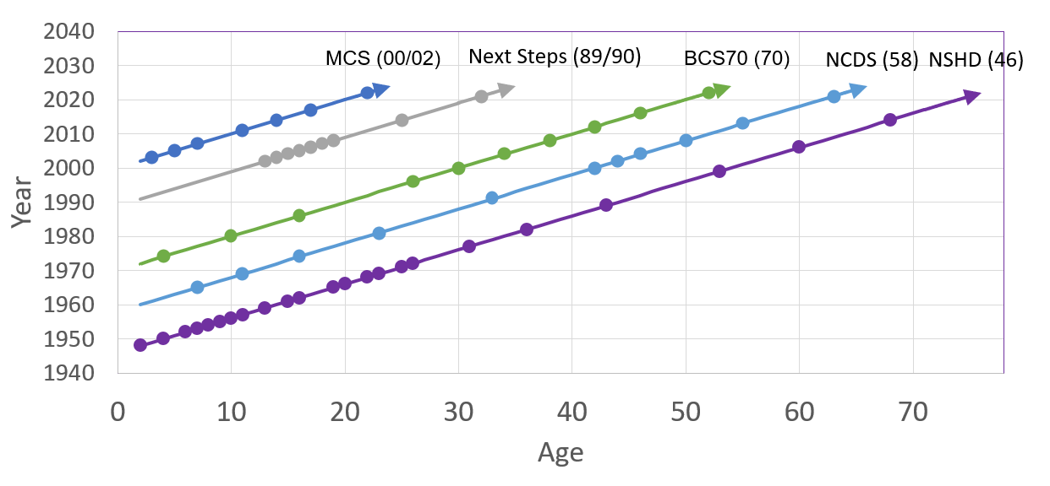
Cohort timelines:

Slide 7
Cohort timelines:
Joshi, H., Bryson, A., Wilkinson, D., & Ward, K. (2021). The gender gap in wages over the life course: Evidence from a British cohort born in 1958. Gender, Work & Organization, 28(1), 397-415.

Slide 8
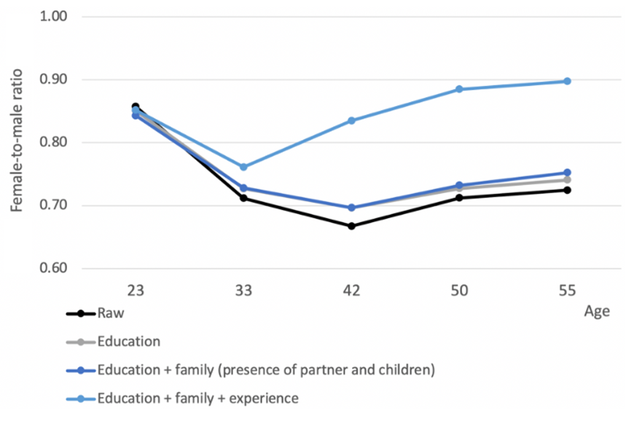
Raw and adjusted ratios in the 1958 cohort

Slide 9
Cohort timelines:
Bryson, A., Joshi, H., Wielgoszewska, B., & Wilkinson, D. (2020). A short history of the gender wage gap in Britain. Oxford Review of Economic Policy, 36(4), 836-854.

Slide 10
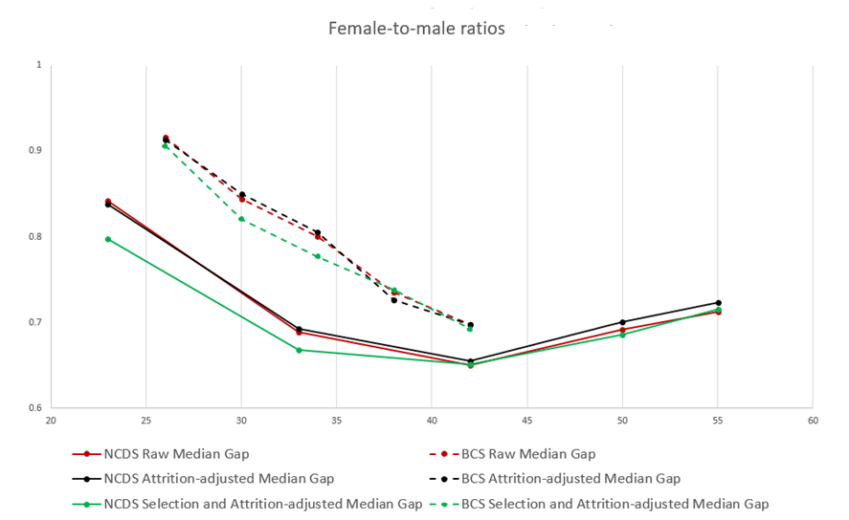
BCS70 and NCDS: selection and attrition

Slide 11
Cohort timelines:
Foliano, F., Bryson, A., Joshi, H., Wielgoszewska, B., & Wilkinson, D. (in press) Gender wage gap among young adults: a comparison across British cohorts. Labour Economics

Slide 12
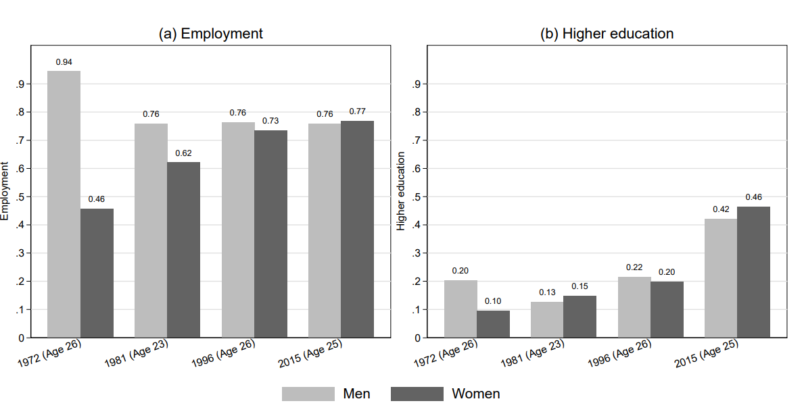
Employment and education gaps

Slide 13
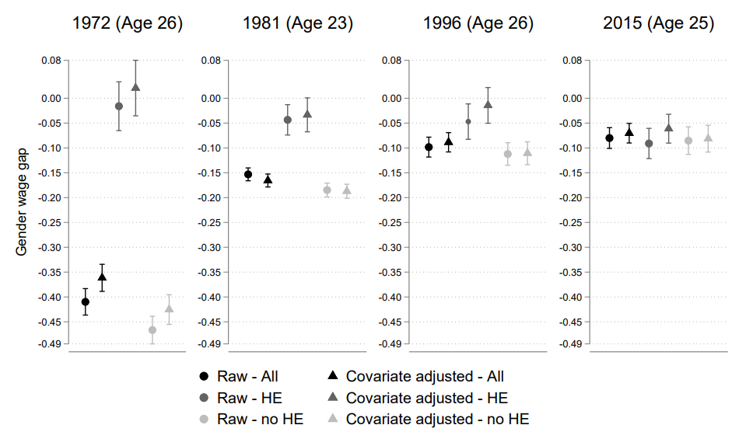
Gender Pay Gap: Young Adults

Slide 14
Cohort timelines:
Wielgoszewska, B., Bryson, A., Costa Dias, M., Foliano, F., Joshi, H., & Wilkinson, D. (2023). Exploring the reasons for labour market gender inequality a year into the COVID-19 pandemic: evidence from the UK cohort studies. Longitudinal and Life Course Studies, 14(2), 180-202.
Wielgoszewska, B., Bryson, A., Joshi, H., Wilkinson, D. (in progress) Gender and paid work in the pandemic: do women pay for working from home?

Slide 15
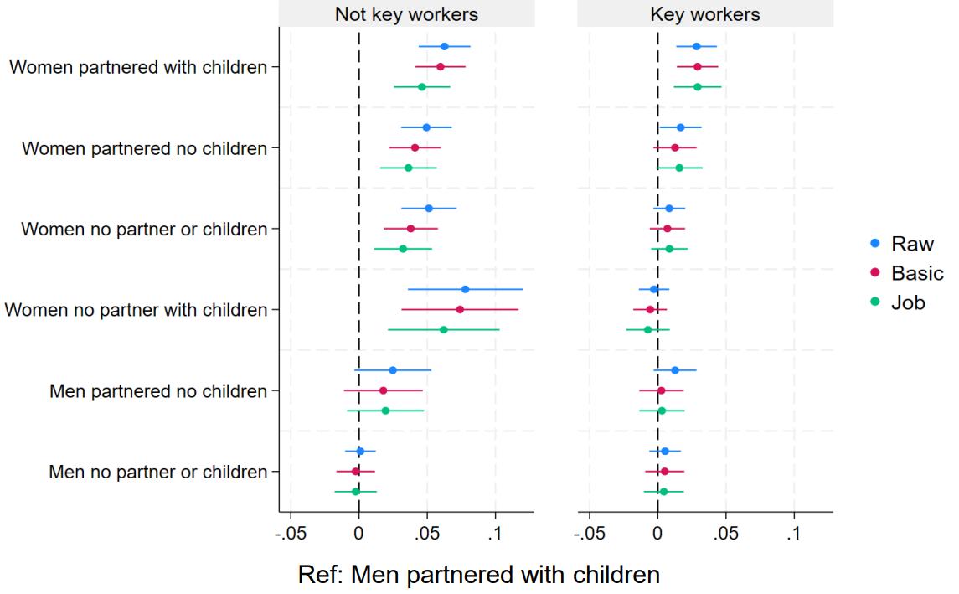
Gender furlough gap during covid-19

Slide 16
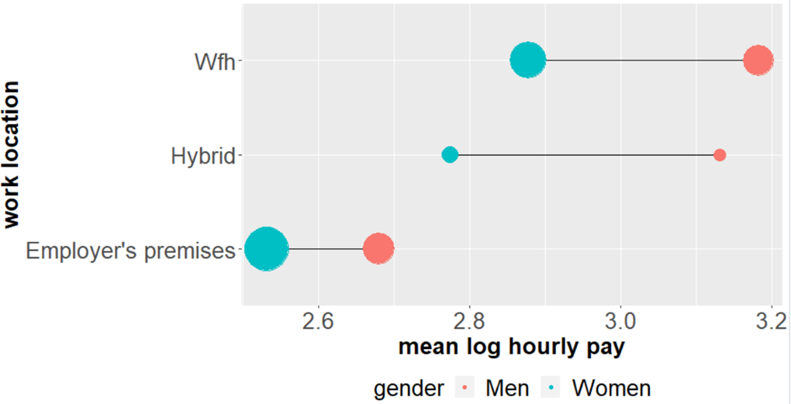
Pay amongst continuing workers
during covid-19 (by gender)

Slide 17
Cohort timelines:
Wielgoszewska, B., Bryson, A., Crawford C., Joshi, H. (in progress) Why are mothers paid less?

Slide 18
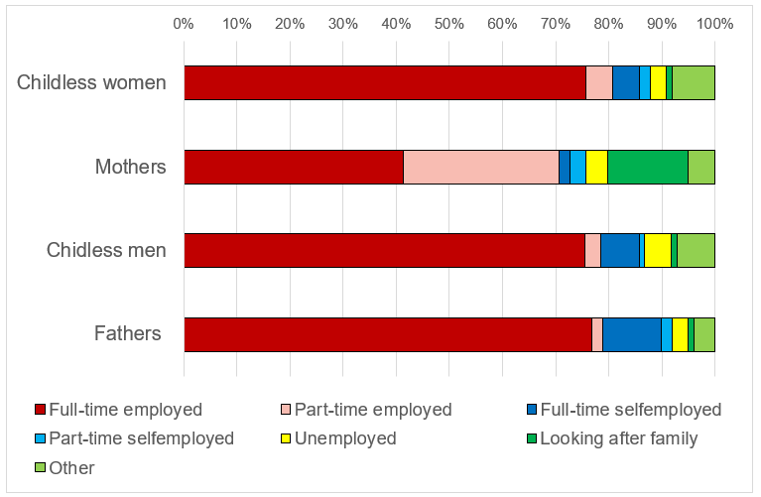
Employment amongst 32-year-olds

Slide 19
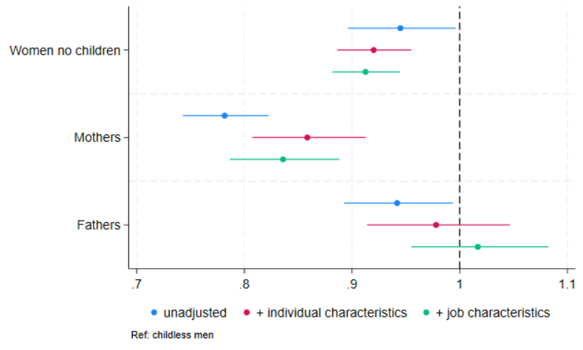
Gender and parenthood pay gaps at age 32

Slide 20
Thank you!
Bożena Wielgoszewska
Email: b.wielgoszewska:@ucl.ac.uk
X: @meBozena
DRTN webinar
2nd October 2024

